Slide 1
Graphical Minimization Methods

Slide 2
Index
Geometry of Logic
n-cubes
Unfolding
Karnaugh maps
Map construction
Wrapping around
SOP synthesis
Groupings
POS synthesis
Multiple minimal forms
Seven-segment Display Controller
Don’t Cares
Quine–McCluskey Method
Expansion phase
Combination phase

Slide 3
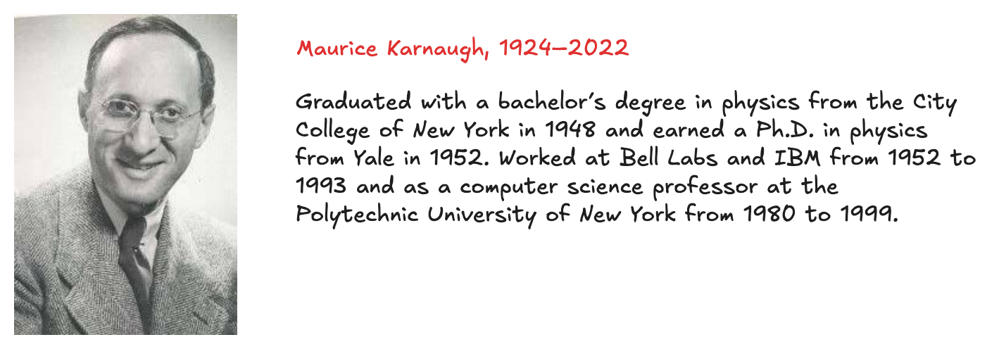
Introduction
K-maps are a graphical method for simplifying Boolean equations
works well for problems with up to four variables
give insight into manipulating boolean equations
invented in 1953 by Maurice Karnaugh, a telecommunications engineer at Bell Labs
Recall that logic minimization involves combining terms
two terms containing an implicant P and the true and complementary forms of some variable A are combined to eliminate A:
PA + PA = P
Karnaugh maps make these combinable terms easy to see by putting them next to each other in a grid

Slide 4
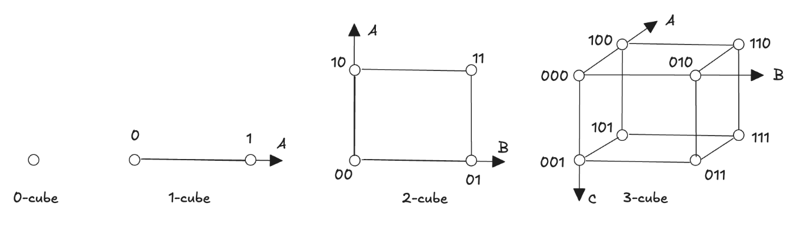
Geometry of Logic (1)
A binary number with n bits can be represented as a point in an n-dimensional space
0 bits, one possible value (0), form a point (0-cube)
1 bit, two possible values (0, 1), form a line segment (1-cube)
2 bits, four combinations (00, 01, 10, 11) form the vertices of a square (2-cube)
3 bits, 8 combination, form a cube (3-cube)
Projecting the 2-cube into a third dimension and adding a 0 or 1 as a suffix, we obtain the 3-cube.

Slide 5
Geometry of Logic (2)
Four-dimensional Cube (4-Cube)
Extends the concept of the 3-cube to four variables
A 4-bit number has 16 combinations → cannot be directly visualized
Represented as two 3D cubes:
Front cube: fourth bit = 0
Back cube: fourth bit = 1
Each cube contains all combinations of the first three variables
Generalization to n-Cubes
0-cube: a single point
n-cube: created by projecting an (n–1)-cube:
Add suffix 0 to all points of the original cube
Add suffix 1 to all points of the projected cube
Logical Adjacency
Moving along one edge of the cube changes only one variable
Points are at distance 1 in the binary space.
This property forms the basis for grouping minterms

Slide 6
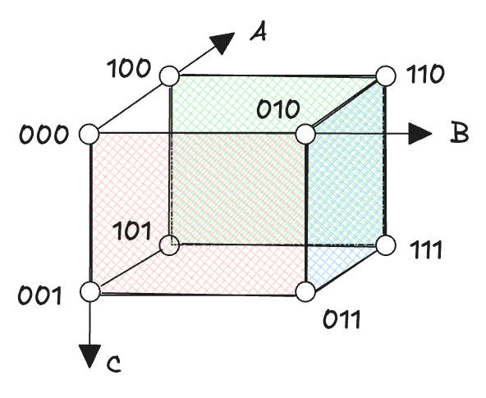
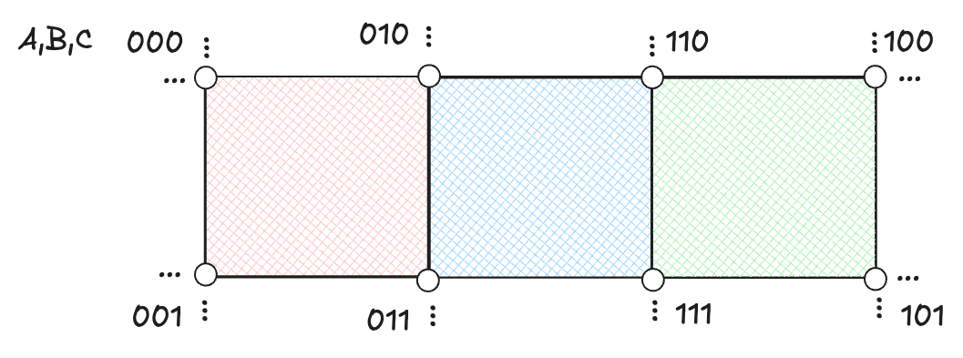
Unfolding (1)
The 3-cube can be unfolded onto a plane to form a two-dimensional layout
preserve spatial adjacency between vertices as much as possible
each vertex represents a unique 3-bit combination
adjacent vertices differ by the value of only one variable
To maintain adjacency, variables are arranged in Gray code order
consecutive combinations differ by only one bit
00 → 01 → 11 → 10 instead of 00 → 01 → 10 → 11

Slide 7
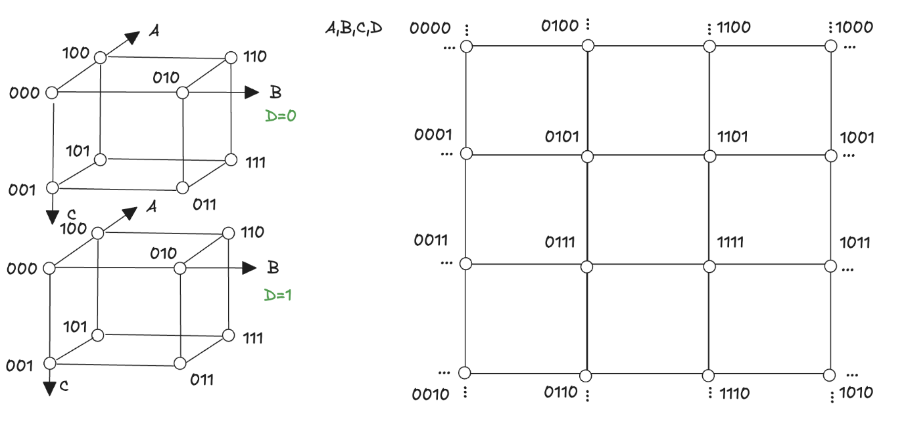
Unfolding (2)
The same projection method applies to higher-dimensional cubes
a 4-cube cannot be directly visualized but can be shown as two connected 3-cubes
adjacency between vertices is preserved using the same Gray code principle

Slide 8
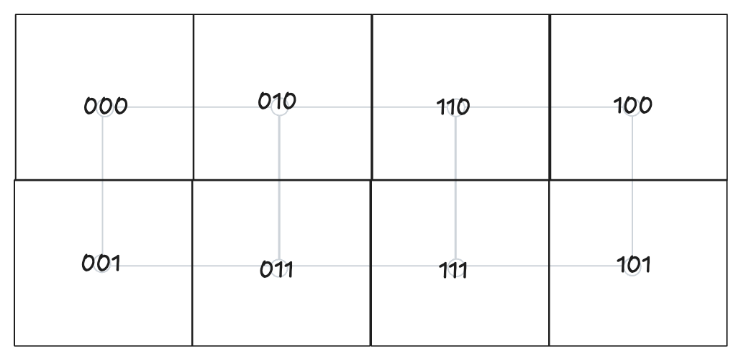
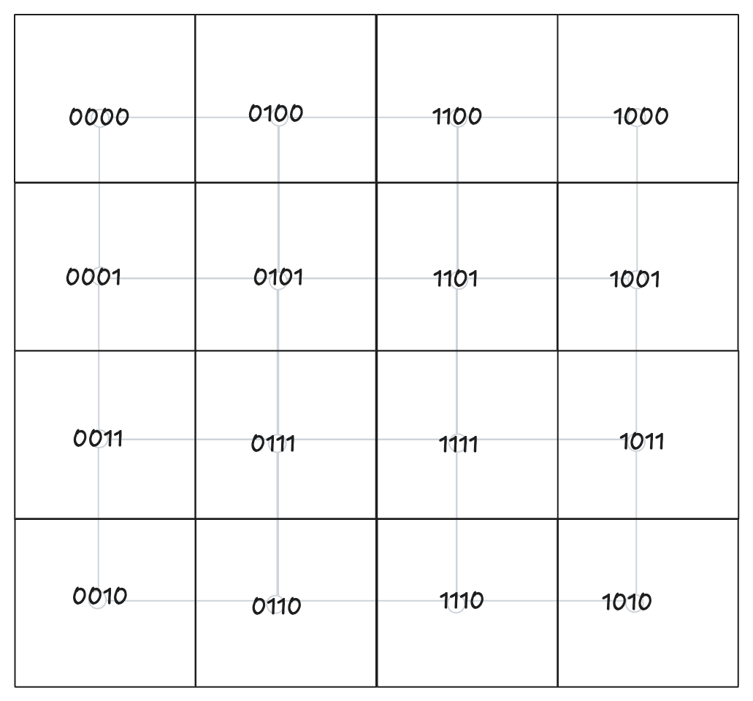
Karnaugh maps (1)
The Karnaugh map is derived from the n-cube representation
each cell in the map corresponds to a vertex (minterm) of the cube
it preserves the topological relationships of the cube:
vertices that were adjacent in the cube remain adjacent in the map

Slide 9
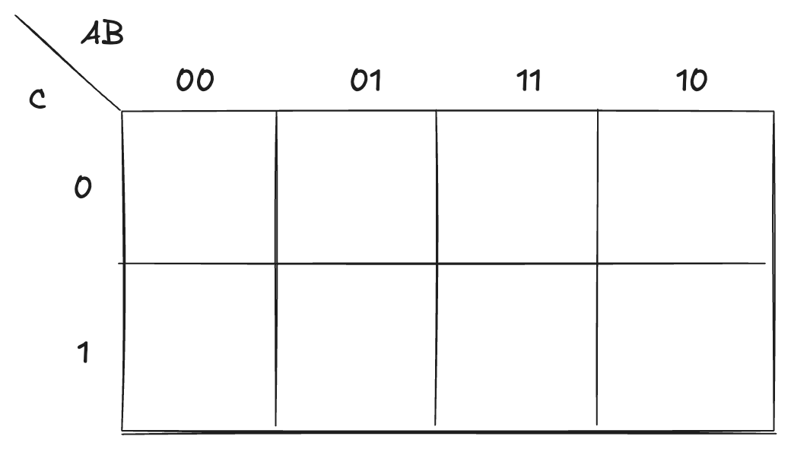
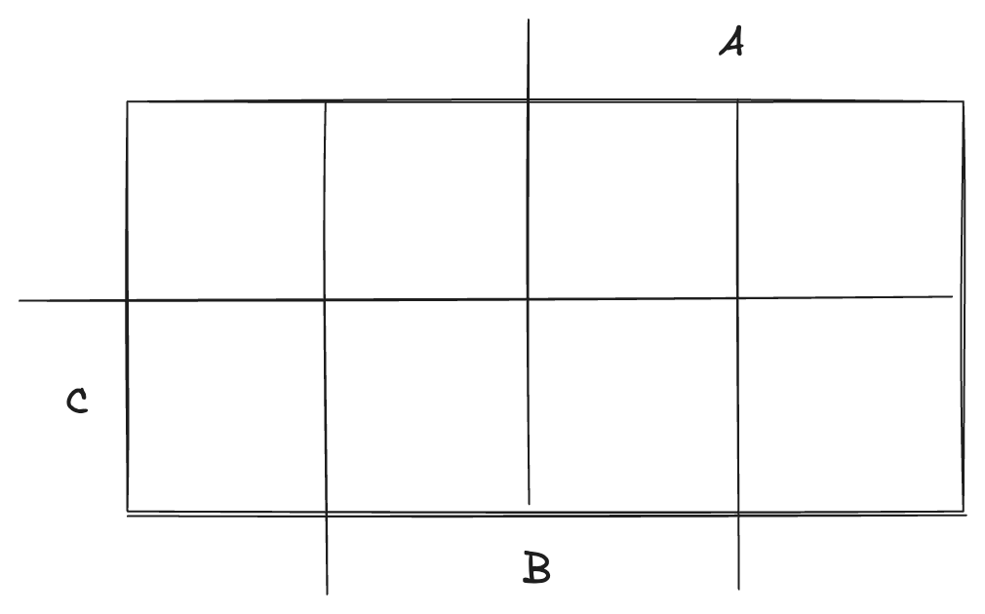
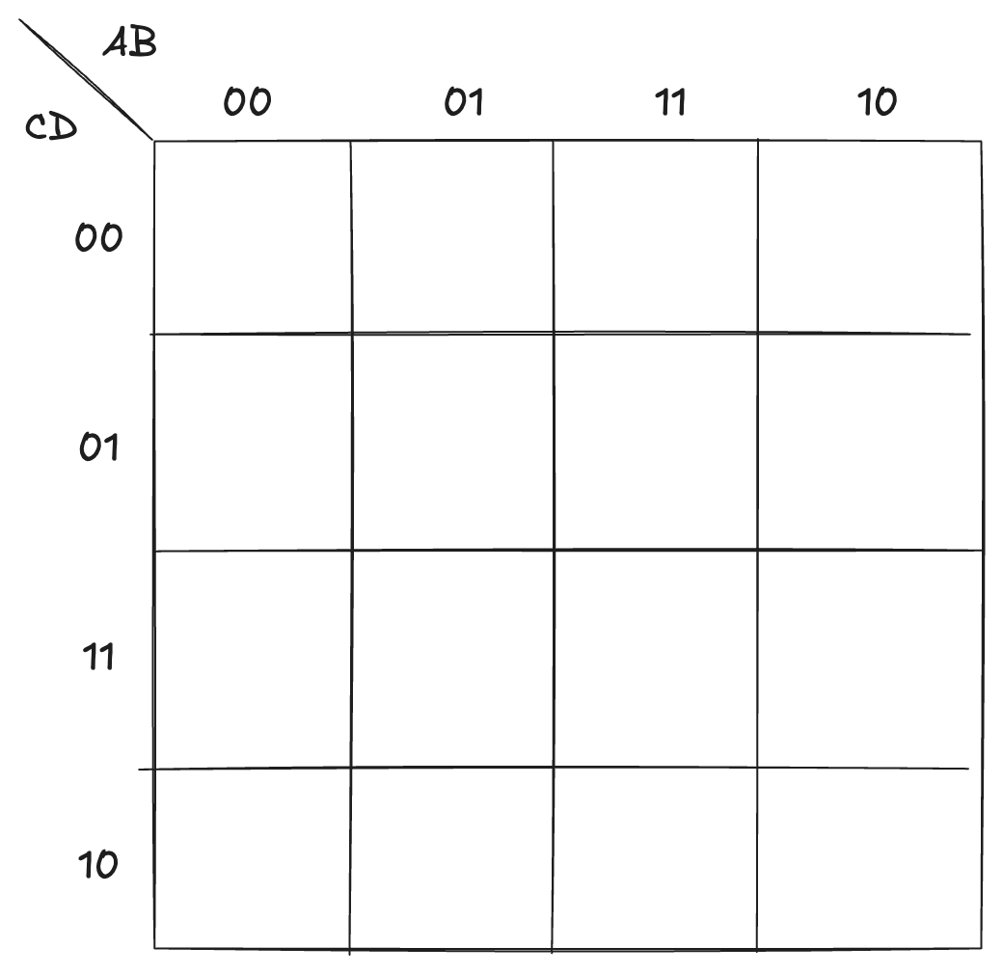
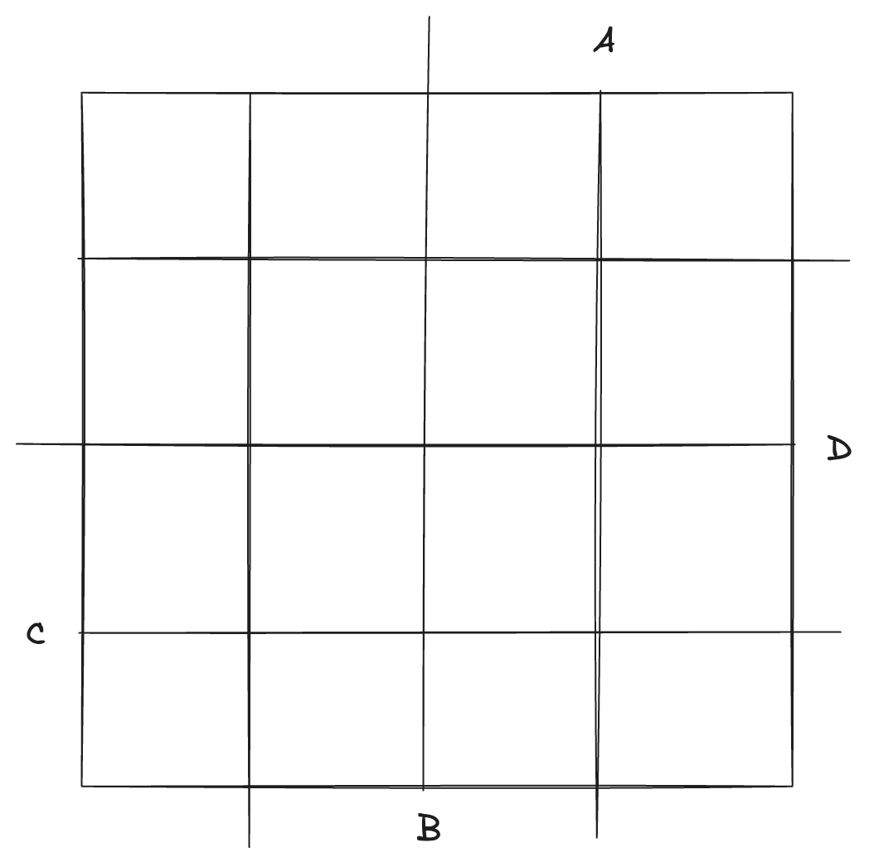
Karnaugh maps (2)

Slide 10
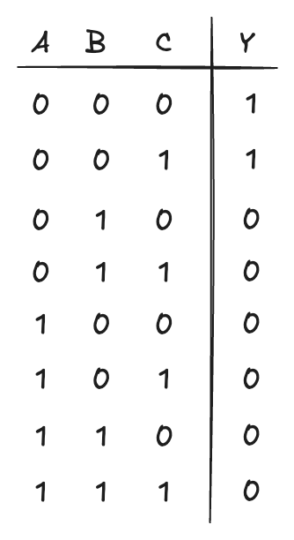
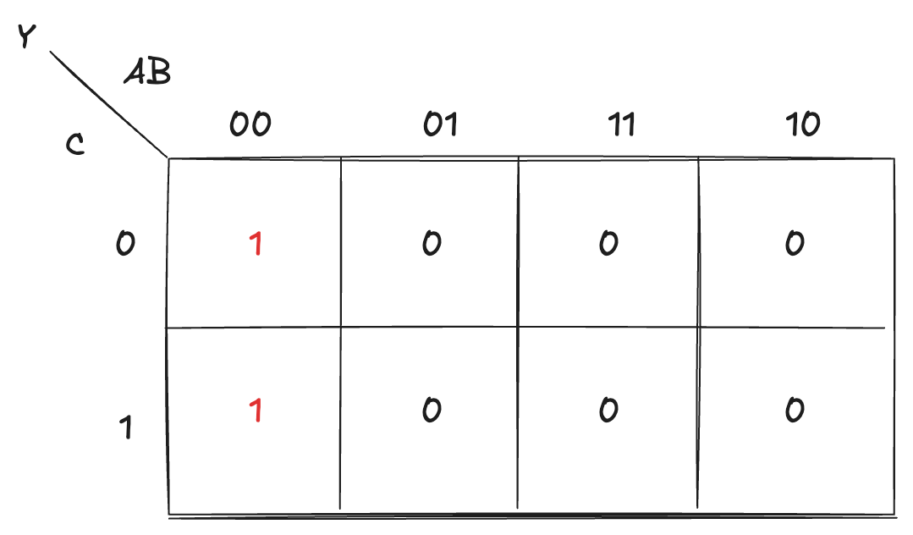
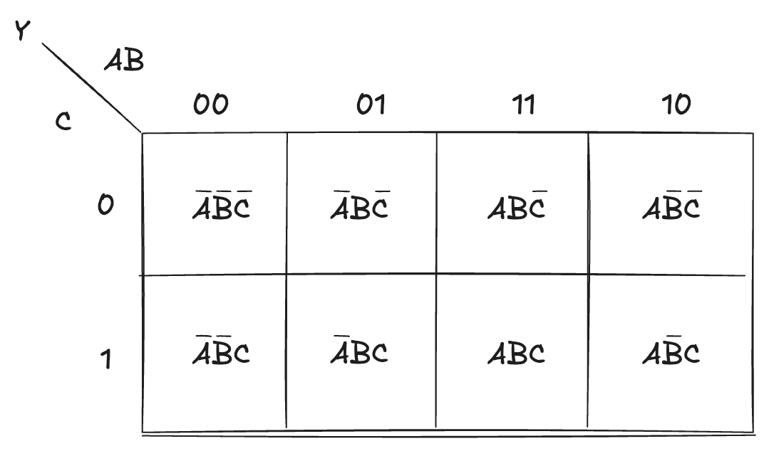
Map construction
We can use the K-map as a graphical reorganization of the true table
each cell corresponds to one row of the truth table
contains the value of the output for that combination
Each square differs from its adjacent squares by the value of only one variable
This characteristic is what makes simplification so straightforward:

Slide 11
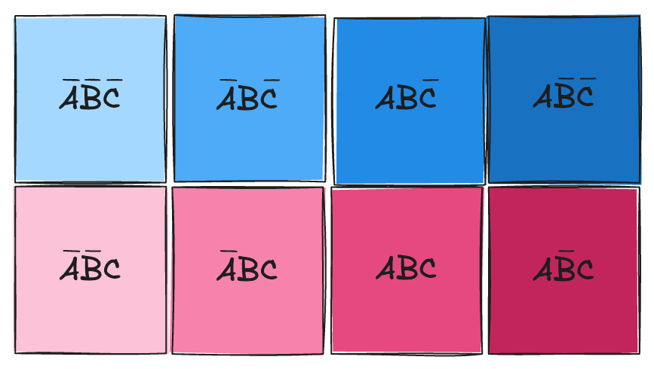
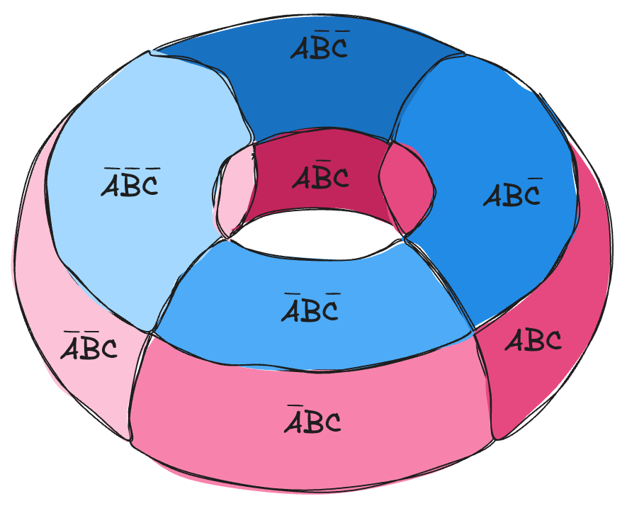
Wrapping around
The map is conceptually arranged on the surface of a torus
first and last columns are considered adjacent
first and last rows are considered adjacent
This spatial organization (adjacency by one-variable difference, Gray code ordering, and wrap-around continuity) is what makes the K-map a powerful visualization tool
It allows us to immediately see which terms can be combined, leading to the simplest possible Boolean expressions with minimal effort

Slide 12
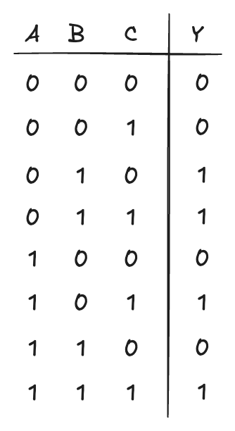
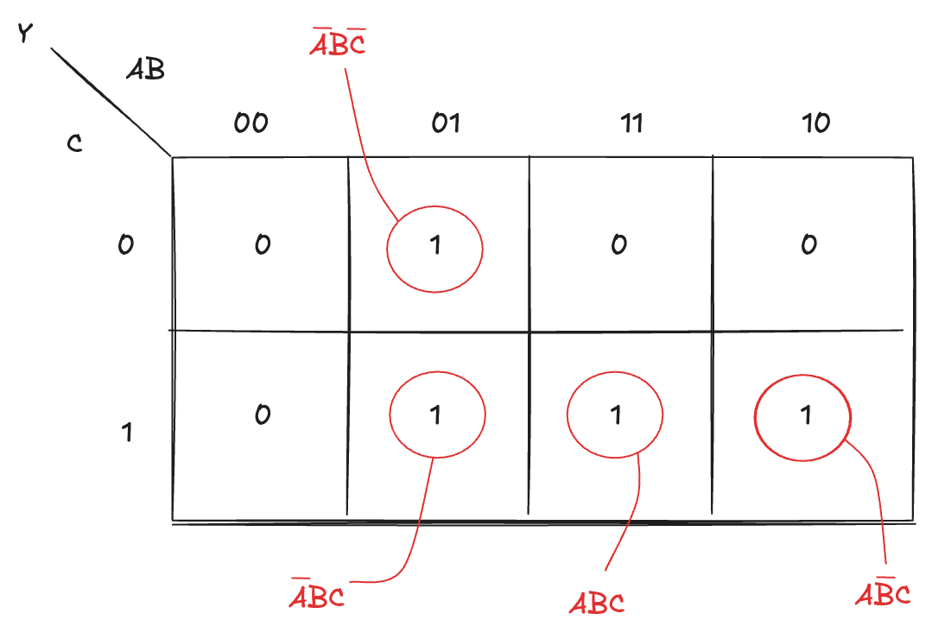
SOP Synthesis
The canonical SOP expression can be derived directly from the map by identifying cells with output 1

Slide 13
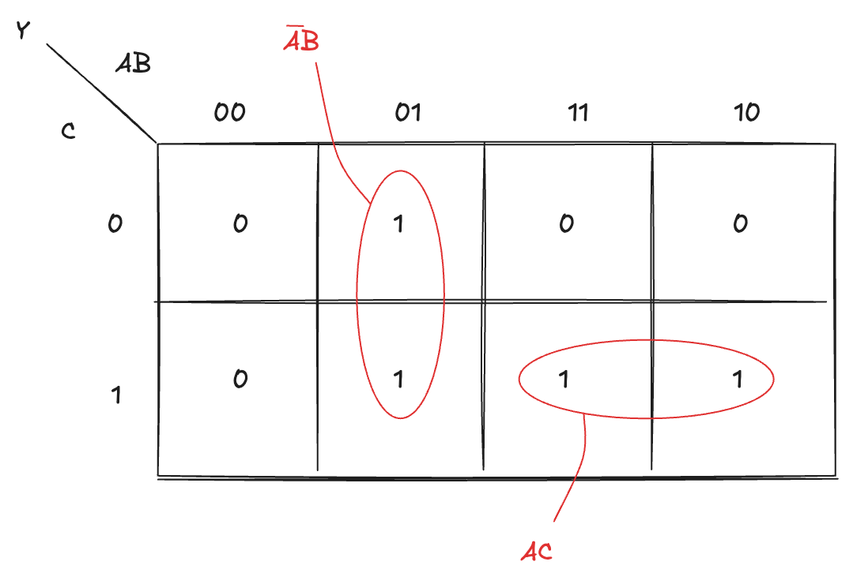
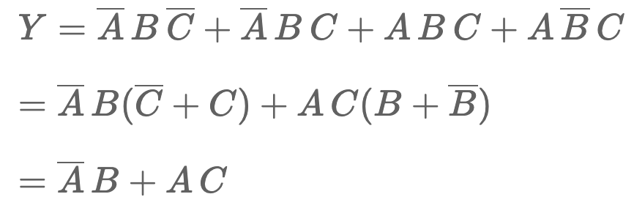
Groupings (1)
Two cells are adjacent when they are at distance 1 (their corresponding input combinations differ by the value of only one variable)
On the map, this means we can group together adjacent 1s that differ in a single variable, forming one-dimensional subcubes, also known as groupings
In each group, one variable changes its value while the others remain constant

Slide 14
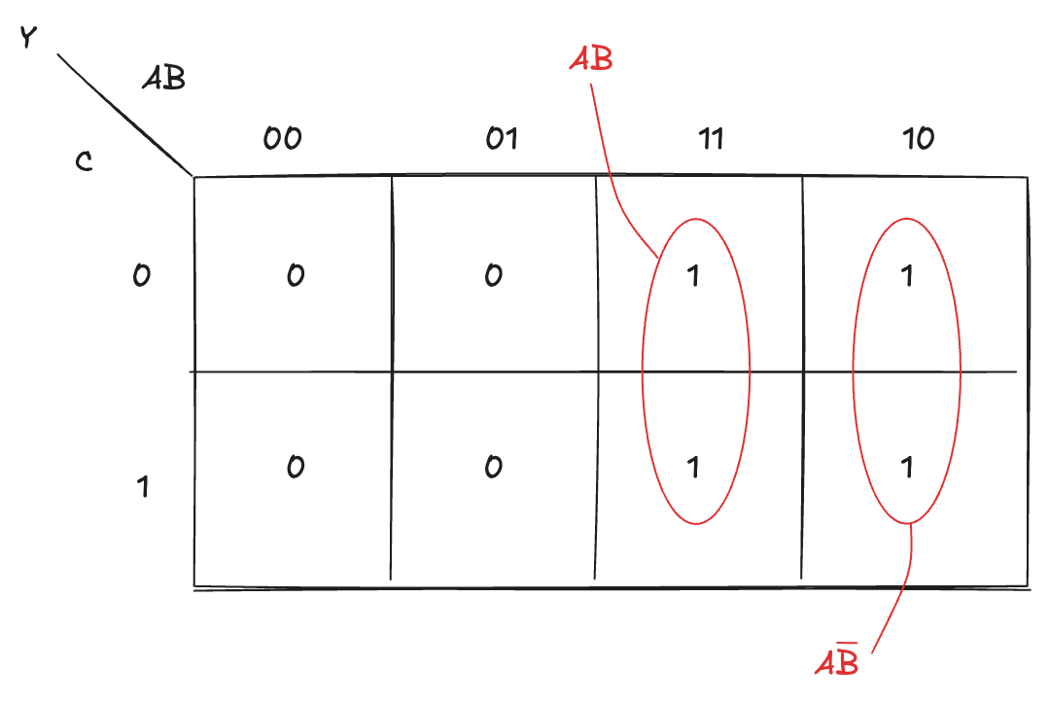
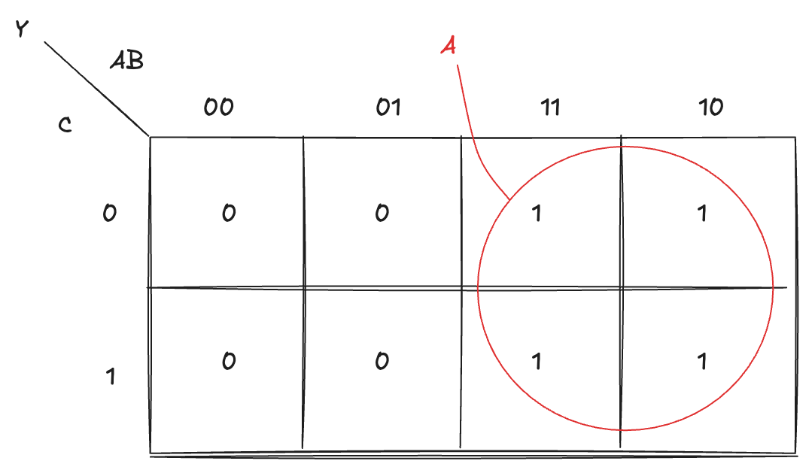
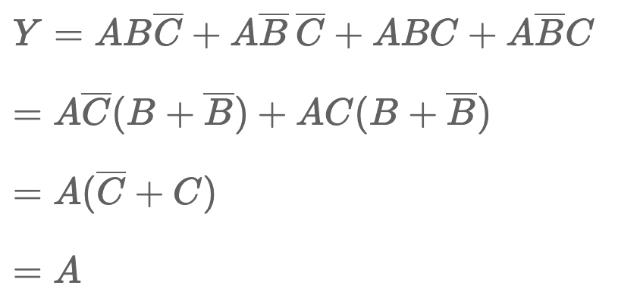
Groupings (2)
we can also form a two-dimensional grouping that includes all four 1

Slide 15
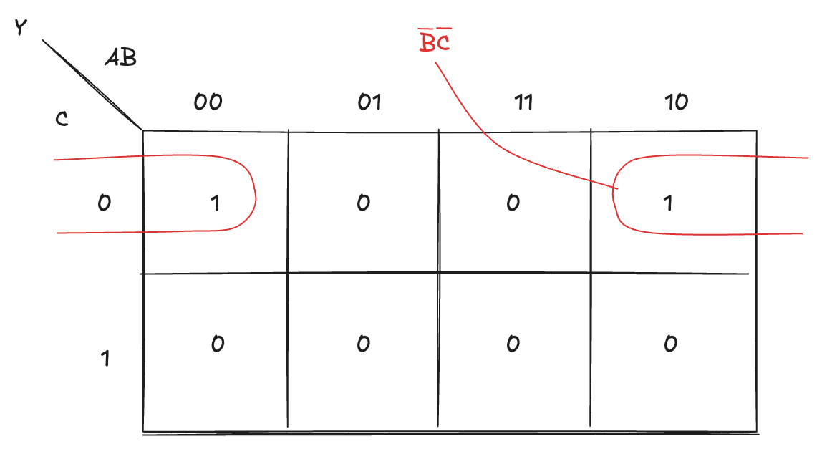
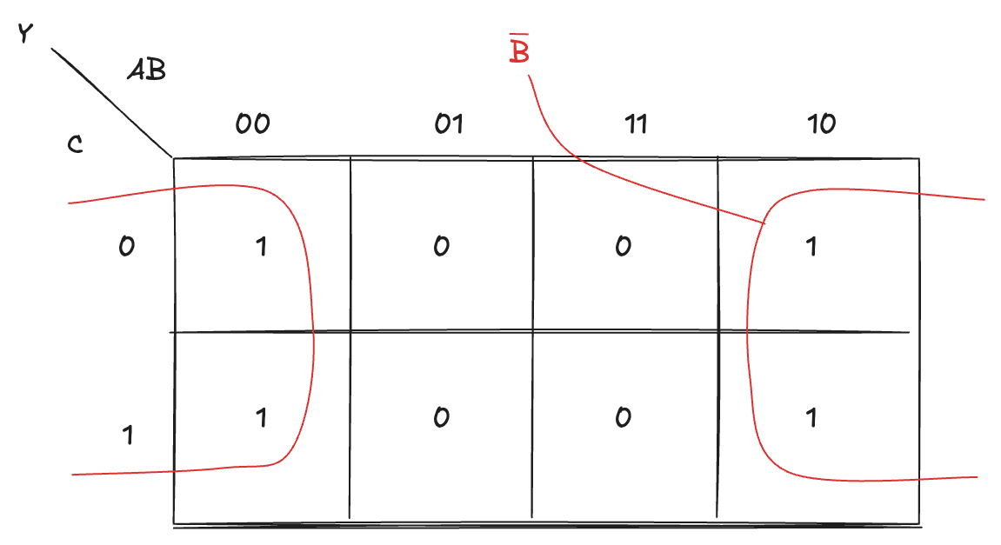
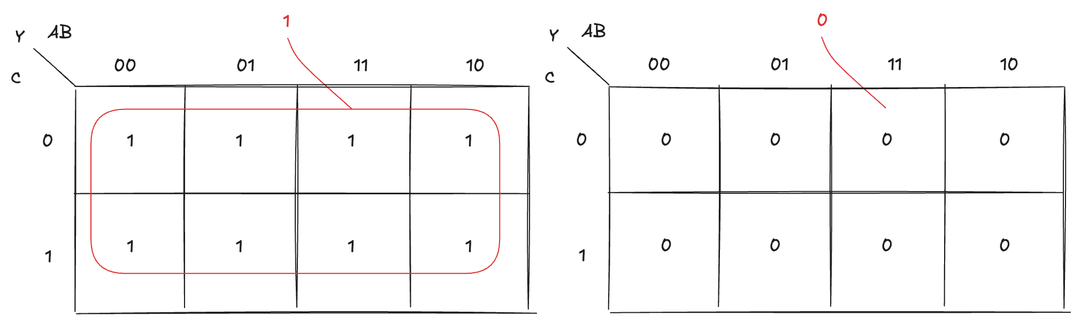
Groupings (3)
In general, we must identify the largest possible subcubes
Remember that the maps is toroidal: wraps both horizontally and vertically

Slide 16
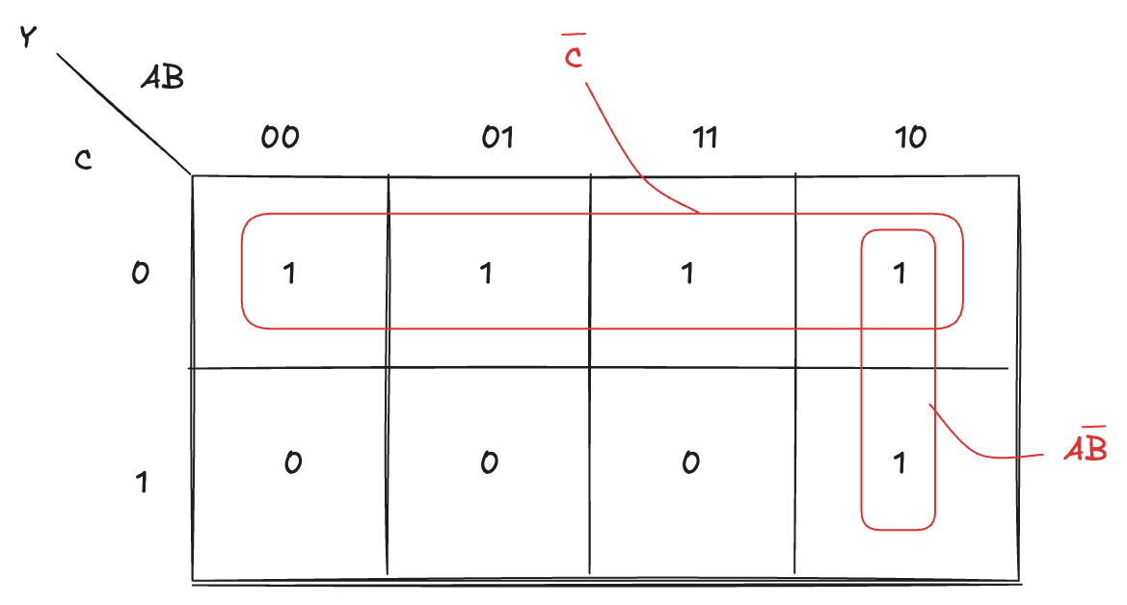

Groupings (4)
A single 1 on the map can belong to more than one group
the same minterm may be covered by multiple overlapping groupings
When different groups share one or more cells, they represent alternative simplifications that all contribute to the final minimized function
The goal is not to avoid overlap but to ensure that all 1s are covered by at least one group

Slide 17
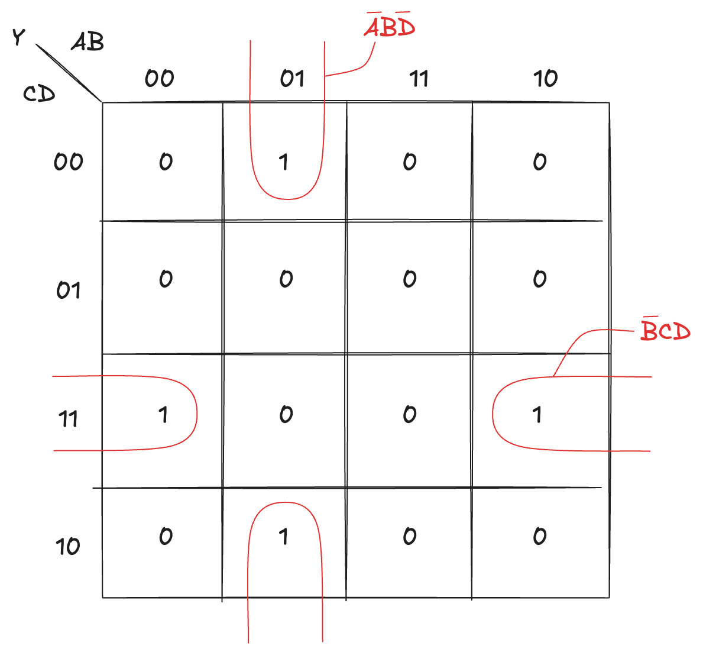

Groupings (5)
The same principle applies to the four-variable map:

Slide 18
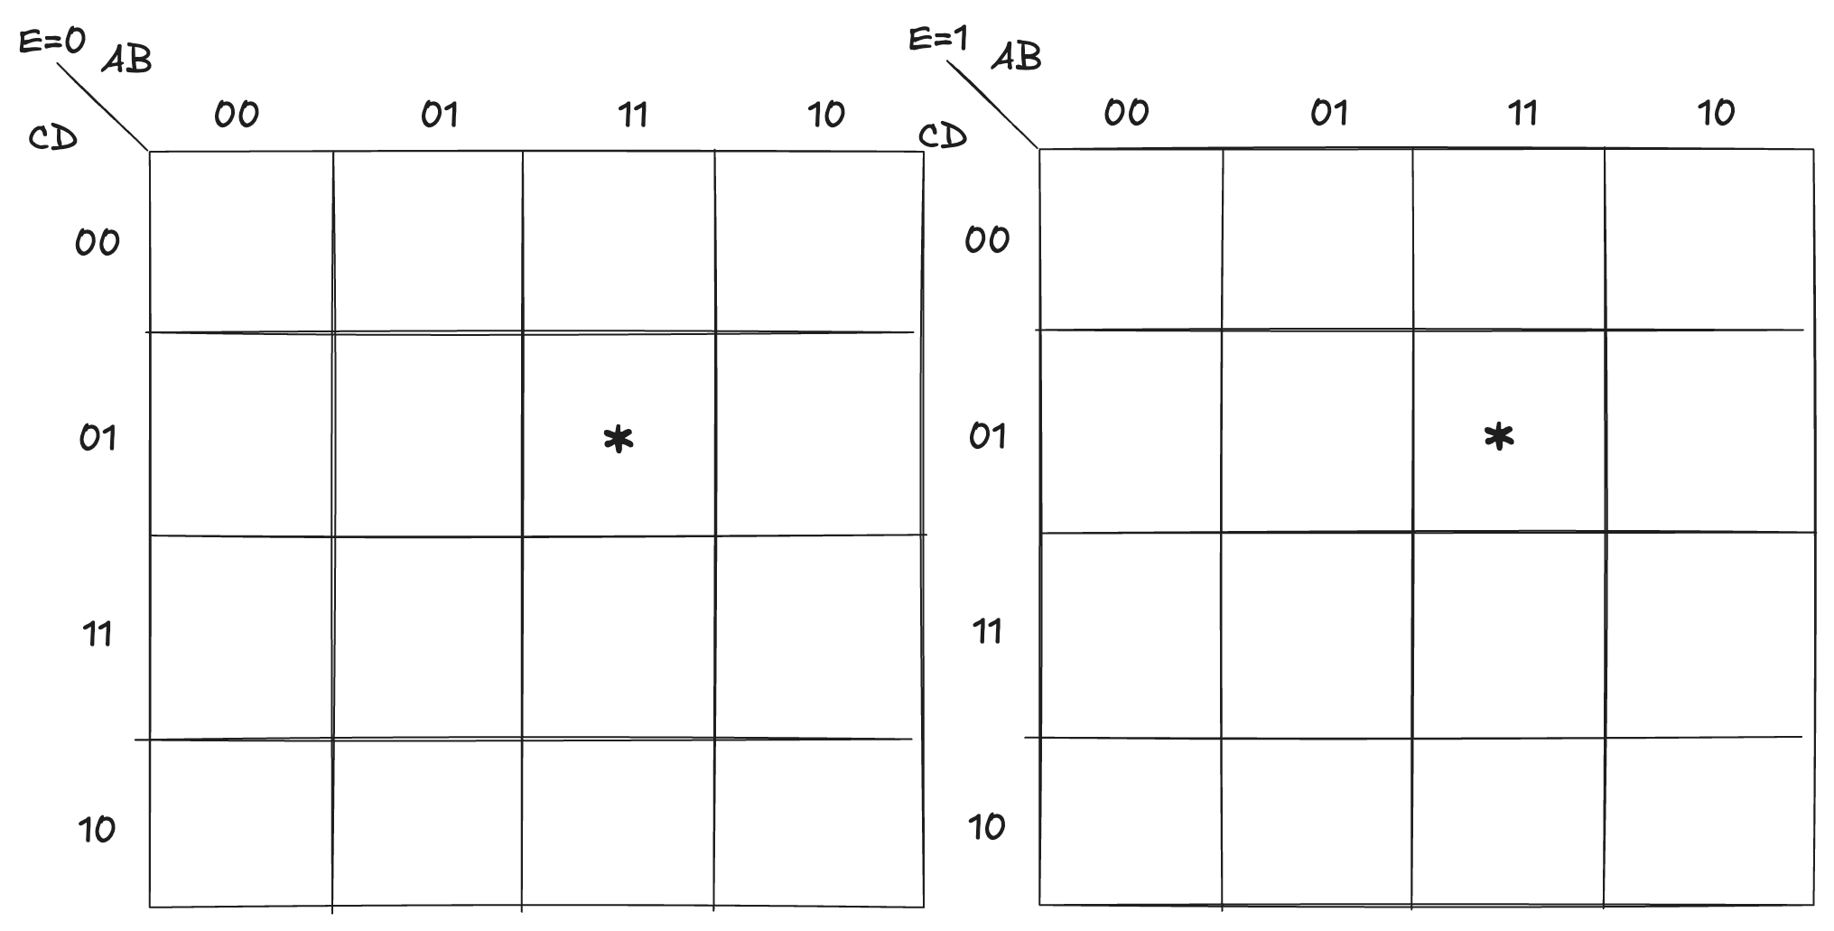
Groupings (6)
Five-variable maps can be represented by two order-4 maps
Cells marked with asterisks are adjacent
they differ by only one variable
can be combined into a single group, allowing the variable E to be eliminated
Six-variable maps are made with four order-4 maps.
However, those maps are too complicated to represent and use

Slide 19
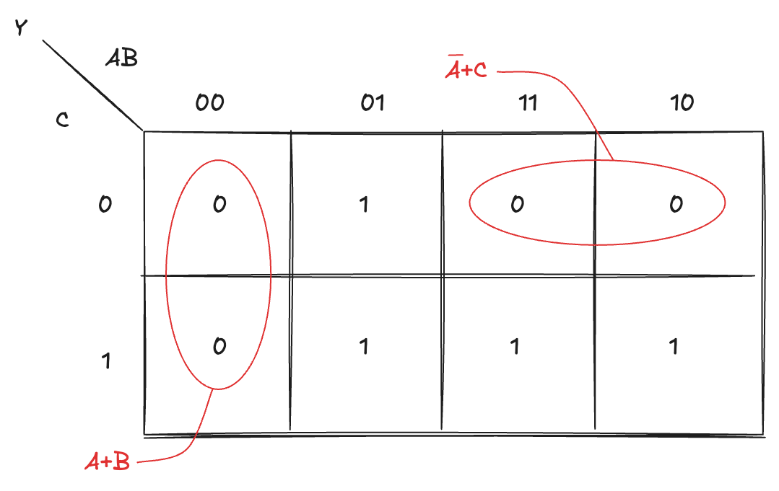
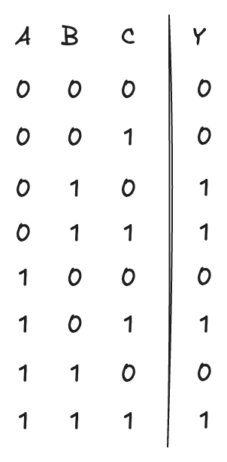

POS Synthesis
We focus on the 0 of the function
each 0 is represented as a sum term
with each variable appearing direct if its value is 0 and negated if its value is 1.
all these OR terms are then combined through an AND operation

Slide 20
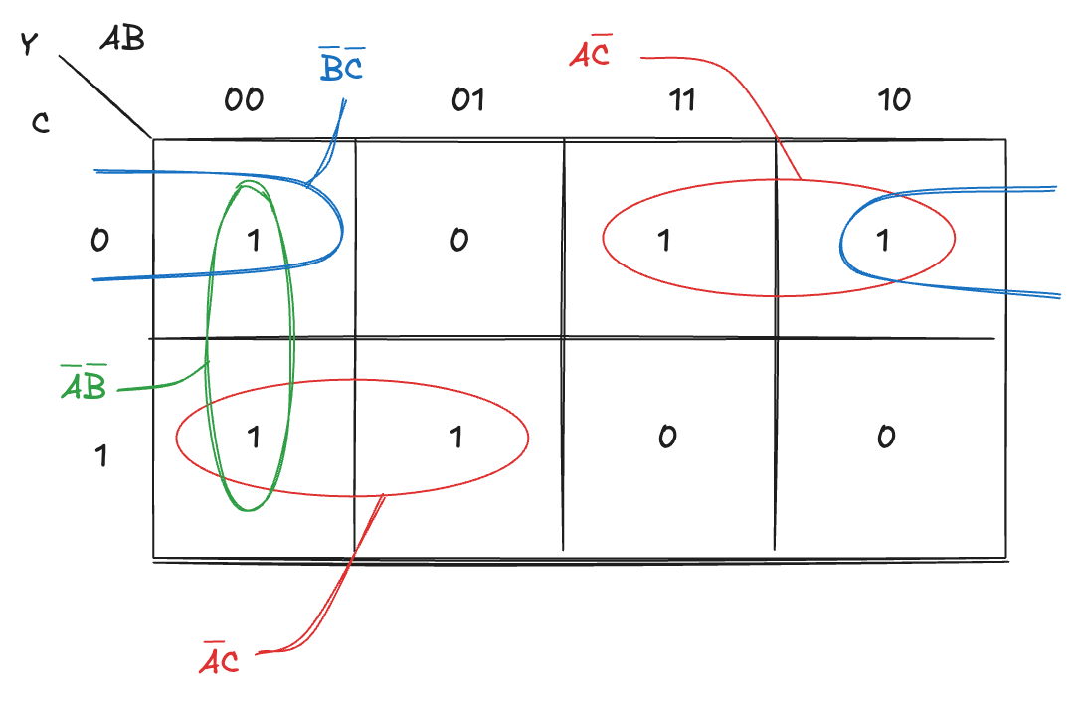
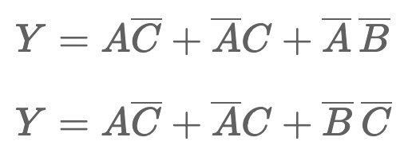
Multiple Minimal Forms
It is important to note that the minimal set of prime implicants is not necessarily unique
There may be multiple valid combinations of prime implicants that cover all the required 1 on the map
Each of these combinations yields a logically equivalent minimal expression

Slide 21
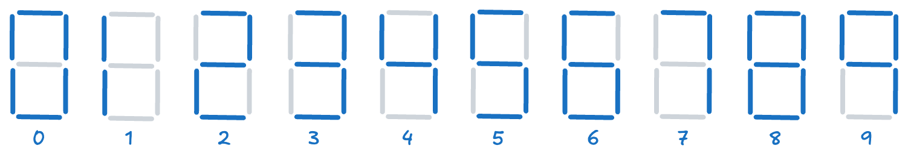
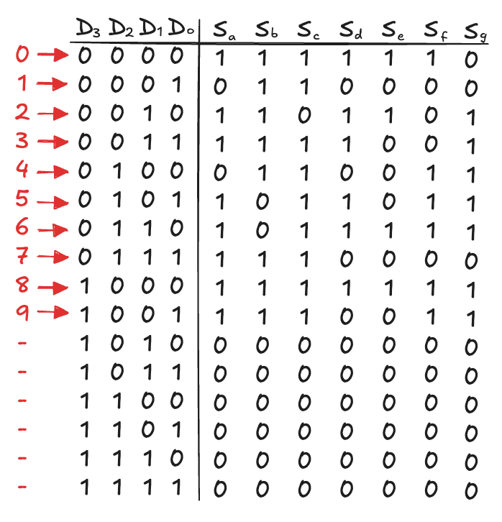
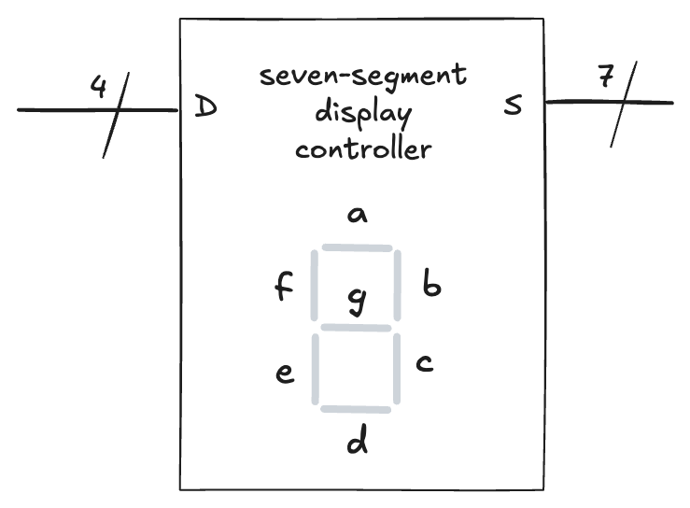
Seven-segment Display Controller (1)
A device that takes a 4-bit data input D_{3:0} and produces seven outputs S_{a} - S_{g} to control a display from 0 to 9

Slide 22
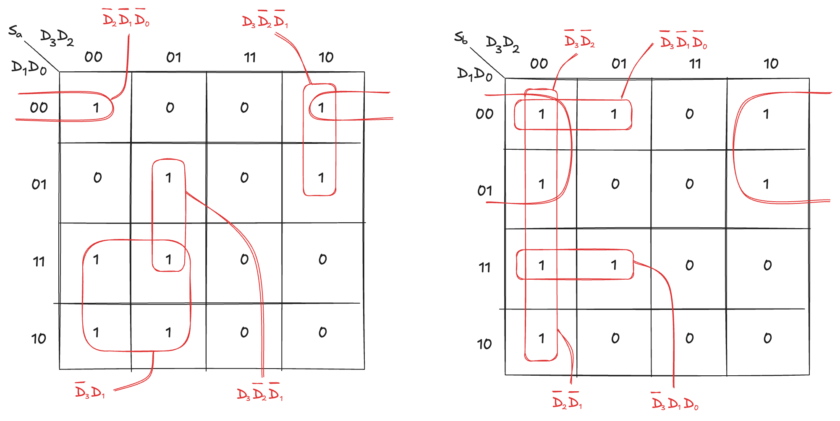
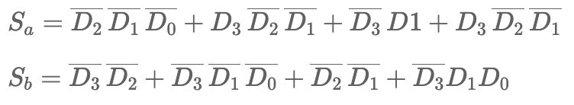
Seven-segment Display Controller (2)
Each of the seven outputs is an independent function of four variables
We can draw K-maps for each outputs

Slide 23
Don’t Cares (1)
Recall that “don’t care” entries for truth table inputs
reduce the number of rows in the table when some variables do not affect the output
they are indicated by the symbol X, which means that the entry can be either 0 or 1
Don’t cares also appear in truth table outputs where:
the output value is unimportant
or the corresponding input combination can never happen
such outputs can be treated as either 0’s or 1’s at the designer’s discretion
In a K-map, X allow for even more logic minimization
they can be circled if they help cover the 1 with fewer or larger circles
but they do not have to be circled if they are not helpful

Slide 24
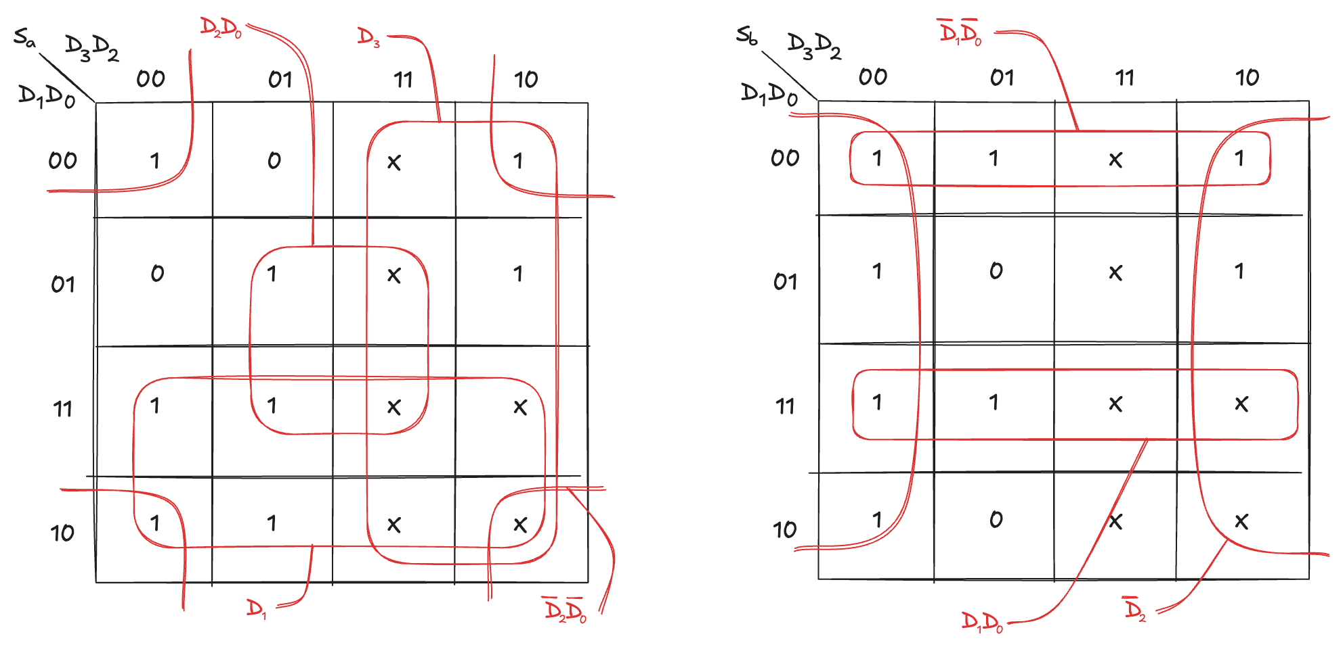
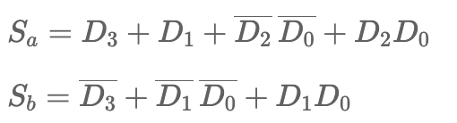
Don’t Cares (2)
We can review the seven-segment display decoder if we don’t care about the output values for illegal input values of 10 to 15
Use of don’t cares simplifies the logic substantially:

Slide 25
Quine–McCluskey Method (1)
K-maps become impractical for expressions involving more than four variables
Quine–McCluskey method is the algorithmic version of the manual process used with K-maps
replace the visual pattern recognition of adjacent 1 with a systematic, tabular comparison of binary terms
It explores the same simplification principle: if two terms differ only by the value of one variable, that variable can be eliminated
It provides an automatable process
can handle many more variables
foundation of logic minimization algorithms used in CAD tools

Slide 26
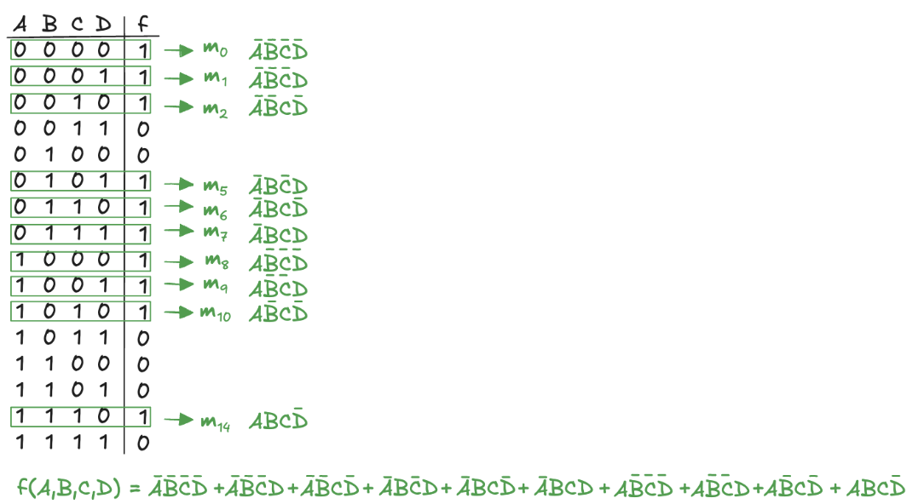
Quine–McCluskey Method (2)

Slide 27
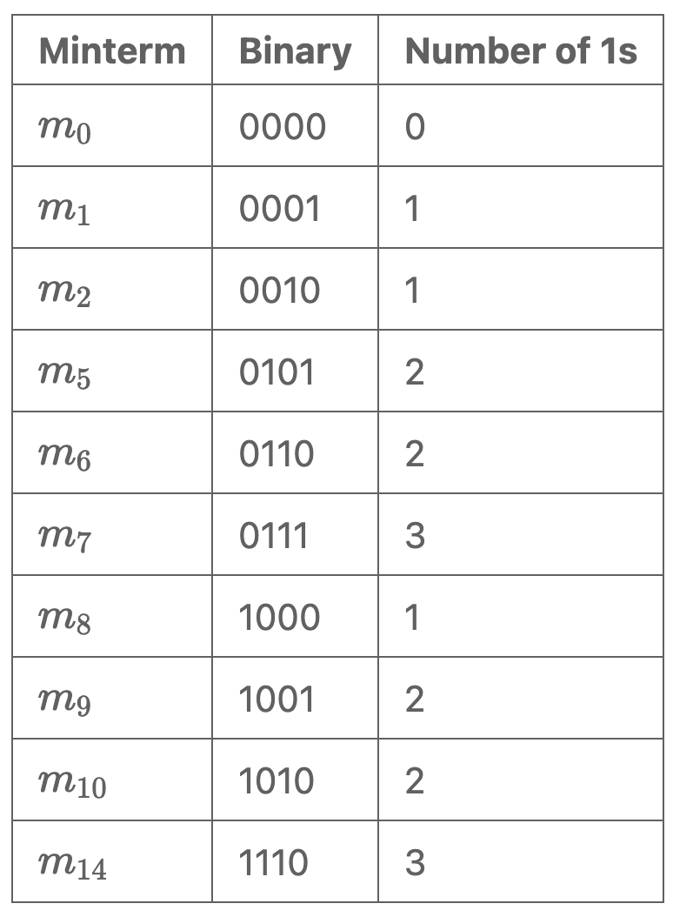
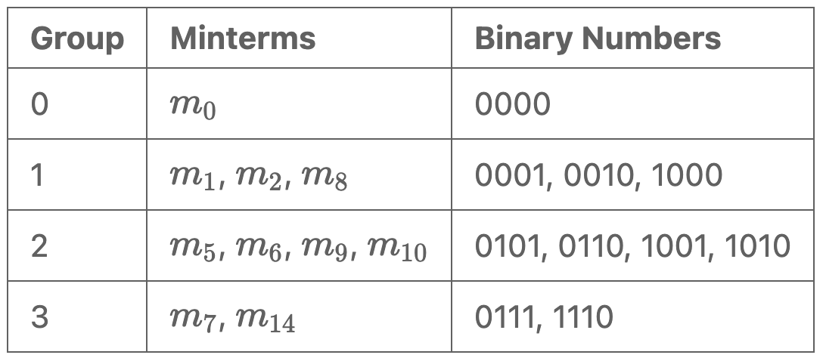
Expansion Phase (1)
Express each minterm with a binary number (with 1s and 0s representing the true and complemented variables)
Group them according to the number of 1s they contain

Slide 28
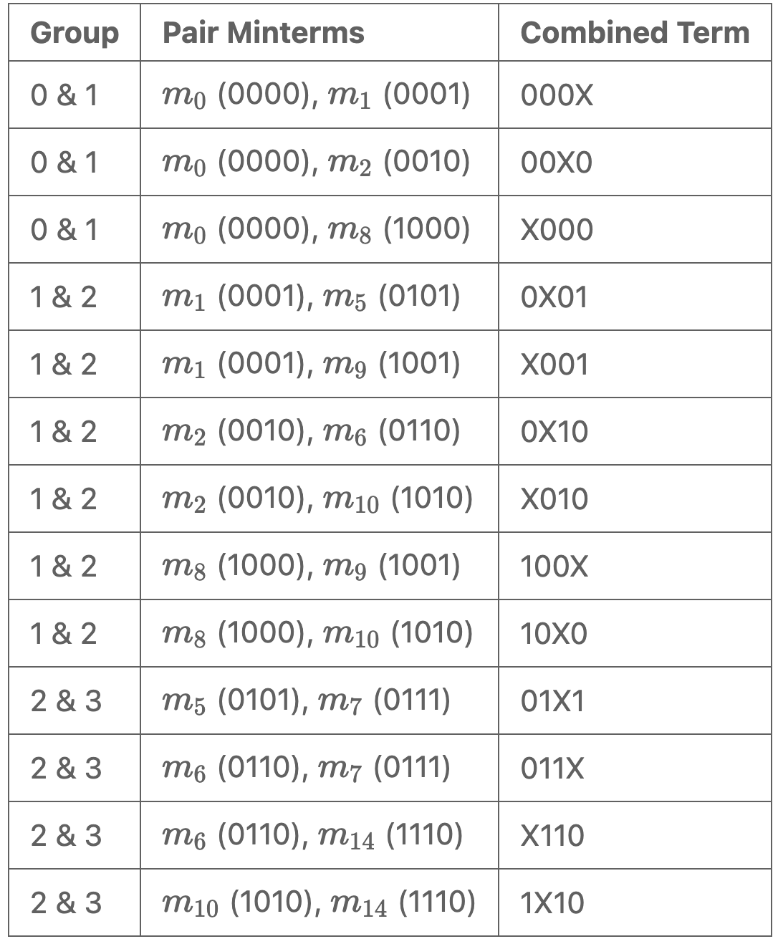
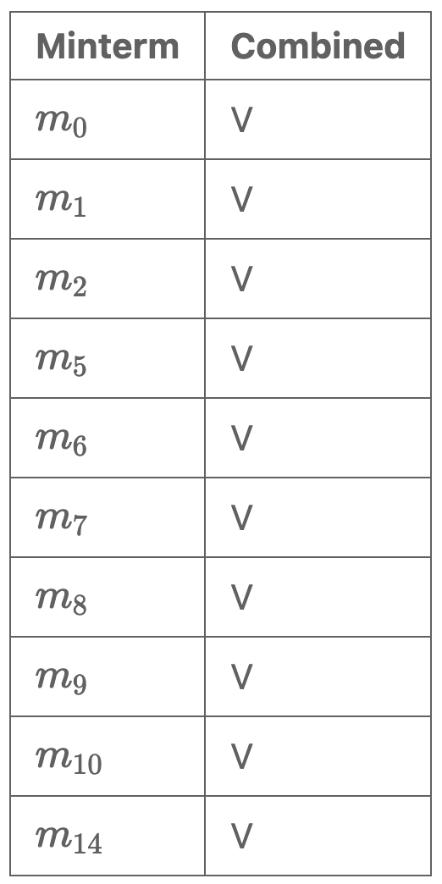
Expansion Phase (2)
Compare minterms in adjacent groups to identify pairs that differ by one bit
Combine pairs into a new terms by replacing the differing bit with a dont'care (X)
Mark every minterm that has been combined with at least one minterm
This process eliminates variables from the expression

Slide 29
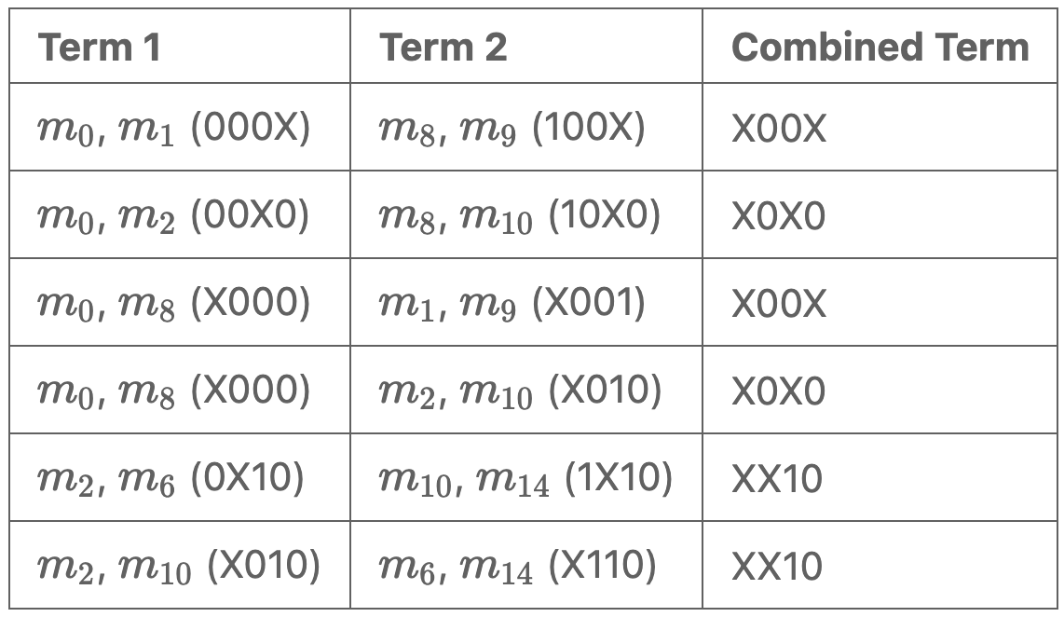
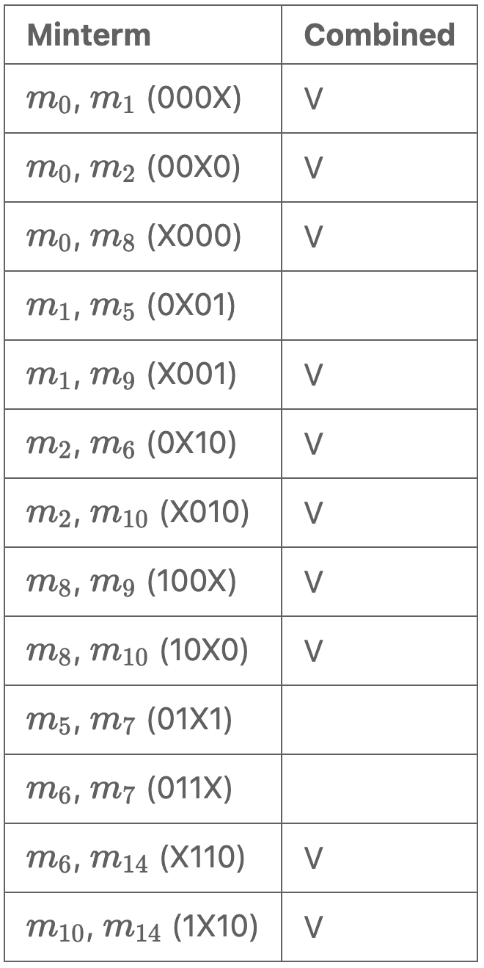
Expansion Phase (3)
This process is repeated iteratively, comparing the newly formed terms to identify additional possible merges
In this step, two terms can be combined only if they differ by a single bit and have their don't cares in the same positions

Slide 30
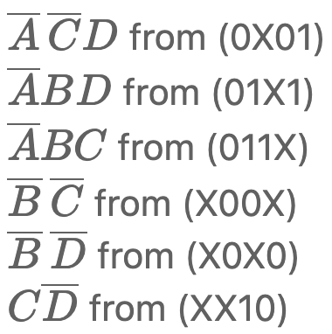
Expansion Phase (3)
This process continues until no further combinations are possible
The terms that have not been combined are identified as prime implicants

Slide 31
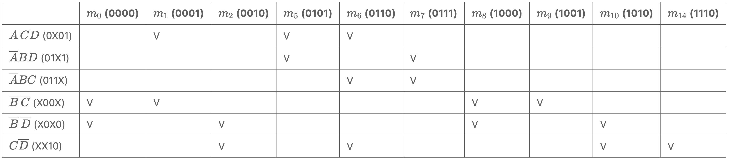
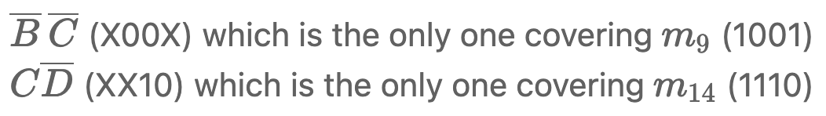



Combination Phase (1)
We have to select a minimal set of prime implicants
Identify essential prime implicants: cover minterms not covered by others
These essential prime implicants, cover also minterms:
Select additional prime implicants to cover remaining minterms:

Slide 32

Combination Phase (2)

Slide 33
Conclusions
K-maps are simple and works well for four variables
Quine–McCluskey: systematic and automatable approach
suitable for CAD tools: tabular structure translates well into software algorithms
Its computational complexity grows exponentially with the number of variables
Modern CAD systems employ heuristic (Espresso algorithm) to find near-optimal implementations of logic functions when exact algorithms become computationally infeasible

